Slide 1
Science Sensors & Science Raft
Walt Innes, Steve Bellavia
System Physicist, System Engineer
Mini workshop
November 6, 2014

Slide 2
Outline
Thermal modeling with SPICE
The model
  Cryo-plate circuit
  PI model
  Cold plate circuit
  Radiation/conduction models
  Refrigeration model
A few results
Summary

Slide 3
PSpice thermal model of an RTM
Use OrCAD Capture and PSpice to describe and simulate an electronic analog of the problem.
This has the advantage of quick simulation of transients enabling the exploration of a large parameter space.
Voltage is the analog of absolute temperature in Kelvin.
Current in Amperes is the analog of heat flow in Watts.
Capacitance in Farads is the analog of heat capacity in J/K.
Resistance in Ohms is the analog of thermal impedance in K/W.
Heat sinks are represented by voltage sources.
Heat sources by current sources.
The large chunks of material are represented as distributed RC networks (very lossy transmission lines) specified by their total heat capacity and their effective thermal impedance.
The heat capacities are taken from a table derived from an ANSYS simulation.
The thermal impedances are inferred from the static thermal solution from that same model as are the resistances that represent the contact thermal impedances.
See the Excel spread sheet, REB_1-D_Model_10-08-2014_revA, from Steve with some help from Jessica Li.

Slide 4
Effects included, or not, in the model
Included
  All known components in one RTM (3 REBs treated as a single larger one).
  All radiative heat paths
  All conductive heat paths
  Refrigerator behavior
  PI control loops ( raft base plate, cryo-plate, REB cold strap connection)
  Assumes high quality heat shields over the REBs (gold flashed Cu foil).
Omissions and limitations
  Emissivities not temperature dependent
  Some emissivities are not well known
  Cryo refrigeration performance may be different
  Refrigerator dependence on compressor ambient temperature.
  Cannot evaluate differences across the raft as the CCDs are one lump.
  Assumes effects such as radiation from the cryostat are uniform over all RTMs. Differences are estimated to be small.

Slide 5
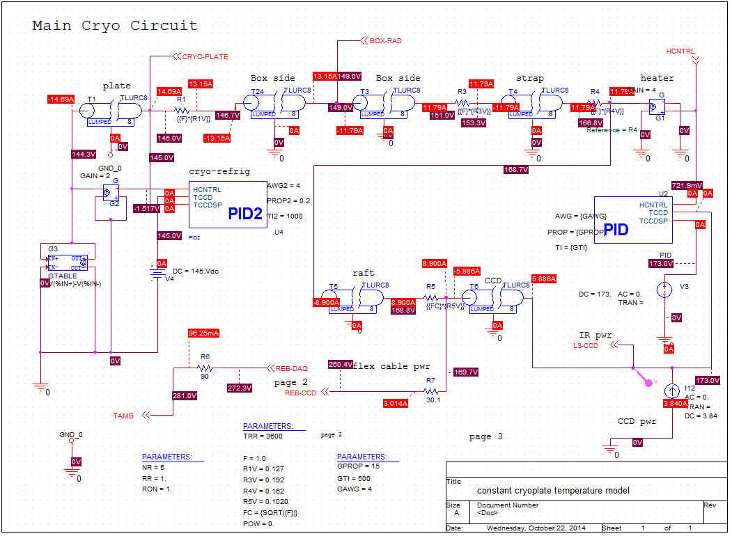
Cryo-plate cooling circuit
PI control loops on the sensors and the cryo-plate, 173 K and 145 K, respectively.
TLURC8 are 8 stage RC lossy transmission lines, which model material.

Slide 6
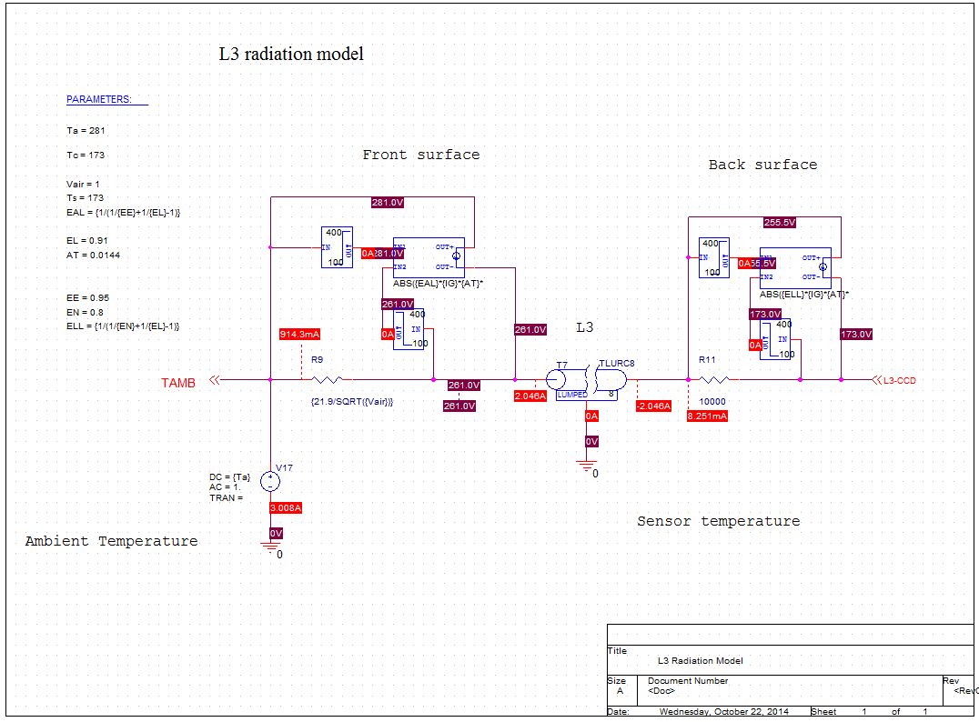
L3 radiation model
The boxes implement black body radiation. Not shown in the formulae are the differences
in the temperatures to the 4th power (IN1⁴-IN2⁴).

Slide 7
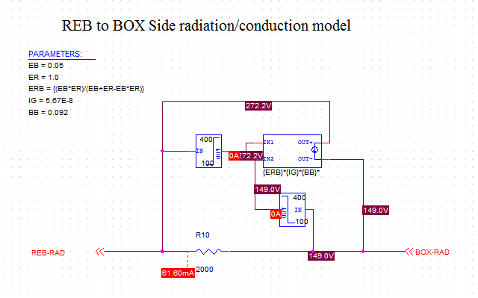
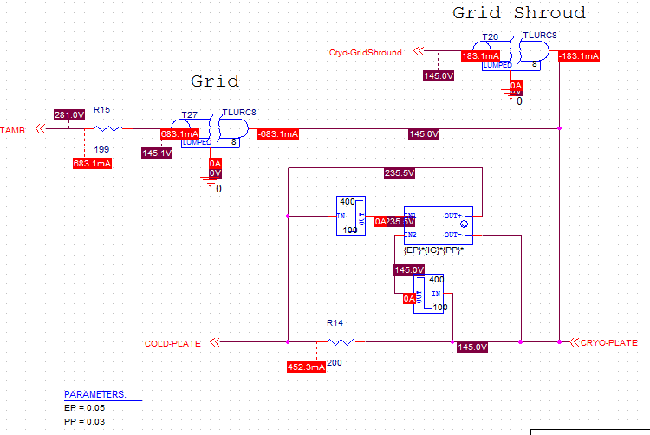
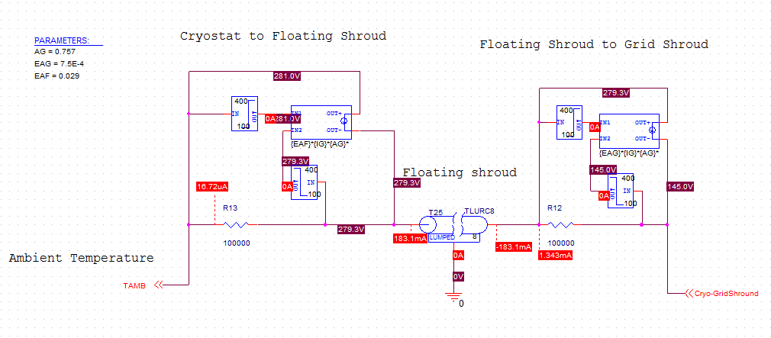
Other radiation models
Cold plate to cryo-plate

Slide 8
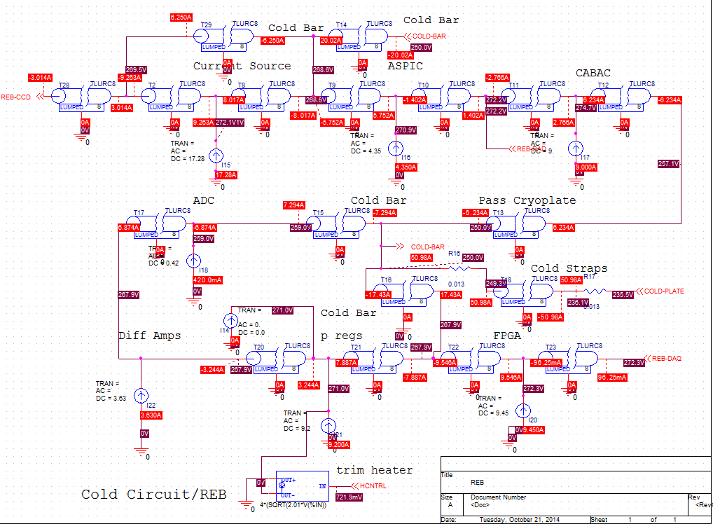
PSpice model of the REB

Slide 9
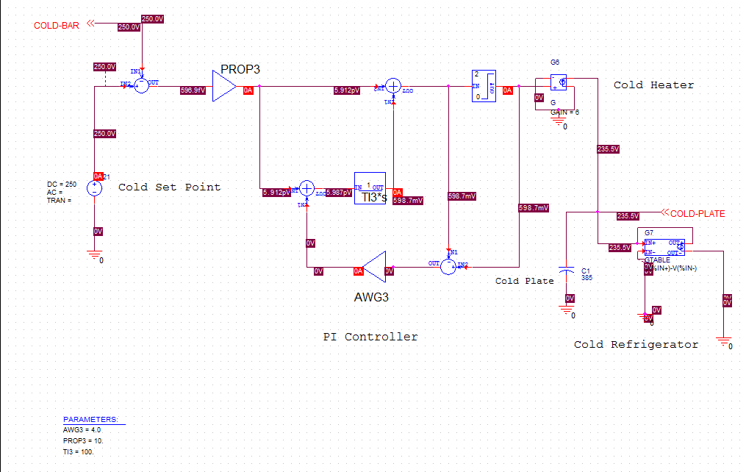
PSpice model of the cold plate control circuit
This model includes 1 RTM portion of 2 refrigeration circuits, the PI loop, and the cold plate heaters. Assumes 22.3 RTMs. (Corner rafts count 1/3 RTM each.) The refrigerator performance is modeled by a lookup table.
Laplace transform
integrator
anti-windup
The PI controllers in the cryo-plate circuit are the same as this one.
(lookup table)

Slide 10
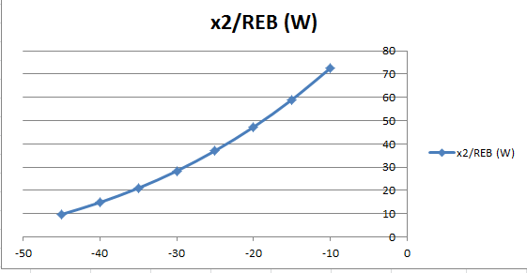
Refrigerator performance (from the manufacturer)
Danfoss GS26CLX with R404A refrigerant
Heat removed (W)
REB heat load
Evaporator temperature (C)

Slide 11
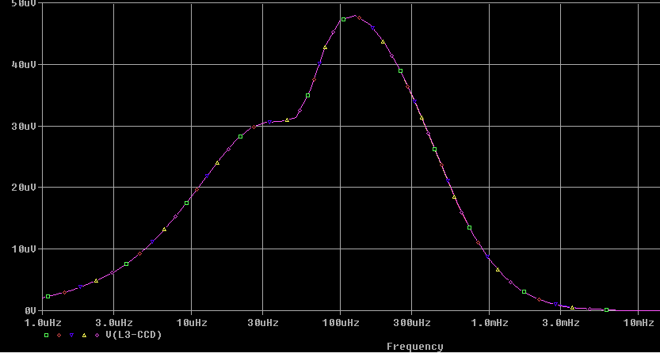
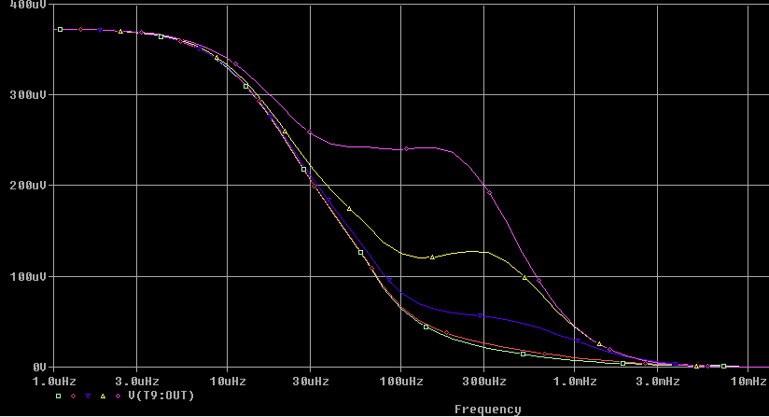
Closed loop response to ambient temperature
Frequency response
50 μK/K
CCD temperature
The different curves are for cold plate
control loop integration times from
20 s to 1000 s.
The longer times have higher values.
0
1 μHz 10 μHz 100 μHz 1 mHz 10 mHz
400 μK/K
ASPIC temperature
0

Slide 12
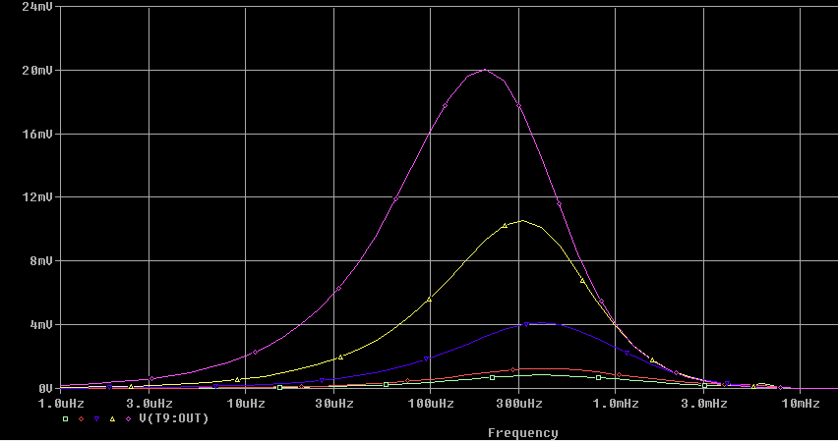
Closed loop response to changes in heat at the power regulators
1 Watt/RTM fluctuation at the power regulators
Temperature response at the ASPIC
Curves as in the previous slide
20 mK/W/RTM
0
1 μHz 10 μHz 100 μHz 1 mHz 10 mHz

Slide 13
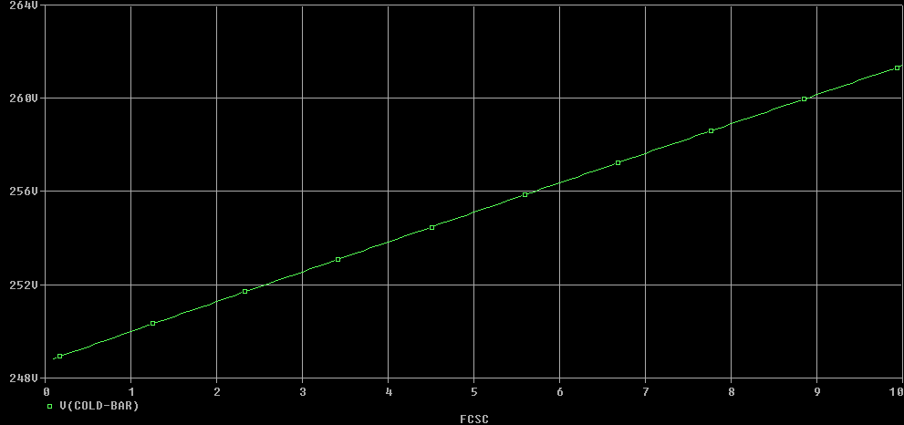
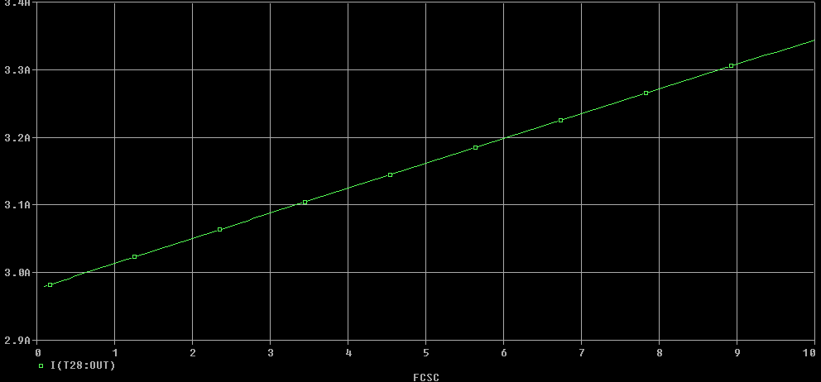
REB to strap and strap to cold plate thermal contact
Open loop (constant cold plate heater value).
Vary both thermal contact impedances by a common factor WRT nominal.
Contact impedances increasing by a factor of 10 has ~ the same effect as losing a refrigerator circuit, i.e., it would increase the flex heat flow by 0.3 W/RTM.
This is the temperature of the cold bar
at the cold-bar/strap interface.
260
Cold bar temperature (K)
250
All values are for one RTM.
3.3
This the heat flow via the flex circuit
from the REB to the sensors.
Flex heat flow (W)
3.0
0 1 5 10
Factor relative to the nominal thermal contact impedance.

Slide 14
Summary
Static solution
  Found a solution with the cold plate at -38 C and the REB/cold strap boundary regulated at -22.3 C. This leaves the CABAC at 2.4 C.
  The heat flow to the CCD via the flex cable is 3.0 W/RTM. This matches the working design point.
  Losing one of the two refrigerators would raise all temperatures by 10 C.
Dynamic response
  The control loops are stable over a wide range of loop parameters.
  The closed loop response to changes in ambient temperature or changes in heat load on the REB are negligible.
  The ability to compensate for changes in refrigerator performance is limited. We may have to control the temperature of the cold plate compressors.

Slide 15
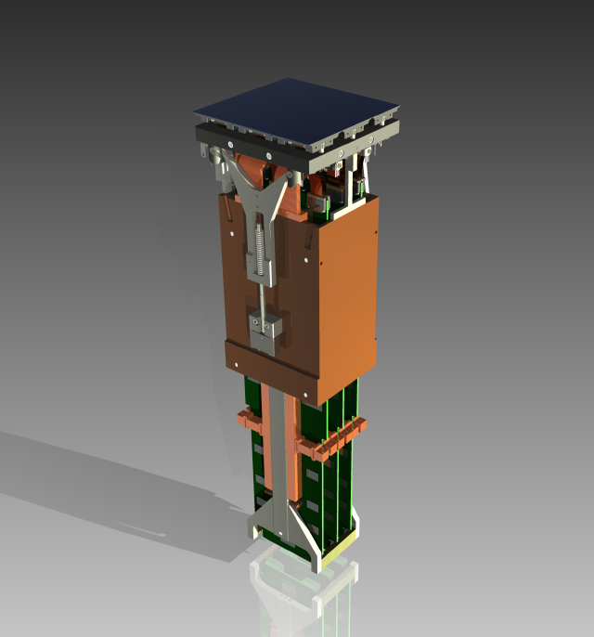
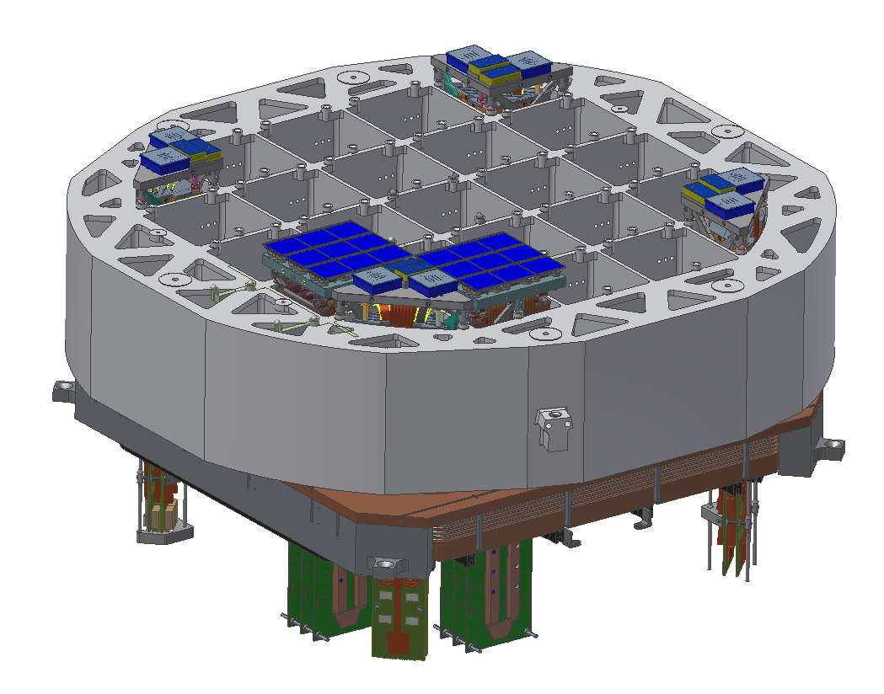
Science Raft Tower Module - RTM
Complete 144-Mpixel imager
Support sensors mechanically to meet strict co-planarity and piston tolerances
Thermal management of sensors and electronics
Protect sensor surfaces from condensable contamination
Low noise analog signal processing
Diagnostics and slow controls
Two custom ASICs (CABAC, ASPIC) on the REB developed by IN2P3 in Paris provide Analog signal processing, CCD bias and clocking
Science Sensors
(CCD’s)
Raft
Baseplate
V-grooves for kinematic mount
Raft Electronics Cage (REC),
Connects to Cryo-plate
pre-tensioning arm
electronics cooling bars,
Connect to
Cold-plate
REB boards
LSST Focal plane consists of 21 Science Rafts + 4 Corner Rafts

Slide 16
End of Presentation

